Slide 1
Lesson 28 Using the Internet and the World Wide Web
Computer Literacy BASICS: A Comprehensive Guide to IC³, 4th Edition
Morrison / Wells

Slide 2
Objectives
Explore the Internet and the Web.
Define Internet terminology.
Connect to the Internet.
Understand browser basics.
Select Web browser settings.
Identify browser issues.
2
2

Slide 3
Vocabulary
ActiveX
cookie
digital certificate
domain
File Transfer Protocol (FTP)
geographic imaging
home page
Hypertext Markup Language (HTML)
Hypertext Transfer Protocol (HTTP)
Internet Protocol (IP) address
Internet service provider (ISP)
podcast
3
3

Slide 4
Vocabulary (continued)
portal
Secure Sockets Layer (SSL)
social networking site
Uniform Resource Locator (URL)
Web 2.0
Web app
Web cache
wiki
4
4

Slide 5
Exploring the Internet and the Web
The Web is part of the Internet.
The Internet can exist without the Web, but the Web cannot exist without the Internet.
The Web began in 1990, when Dr. Tim Berners-Lee wrote a small program for his own use called Hypertext Transfer Protocol (HTTP).
HTTP became the language computers use to transmit hypertext documents over the Internet.
Dr. Berners-Lee then developed Hypertext Markup Language (HTML), which creates hyperlinked documents.
5
5

Slide 6
Exploring the Internet and the Web (continued)
In 1993, the number of people using the Web increased significantly.
Marc Andreessen, working for the National Center for Supercomputing Applications at the University of Illinois, released Mosaic, the first graphical browser.
With the introduction of Mosaic and Web browsers that followed, the Web became a communications tool for a much wider audience.
In 2004, the phrase Web 2.0 was coined. The most popular definition refers to Web sites where users can modify content.
6
6

Slide 7
Defining Internet Terminology
Active X is a programming interface developed by Microsoft for Windows. This set of rules controls Windows programs that are downloaded from the Internet and then run in a browser.
A cookie is a small text file that Web sites put on your computer to store information about you and your preferences.
You need to balance the ease of use provided by cookies with security concerns and the amount of storage space available on your computer.
7
7

Slide 8
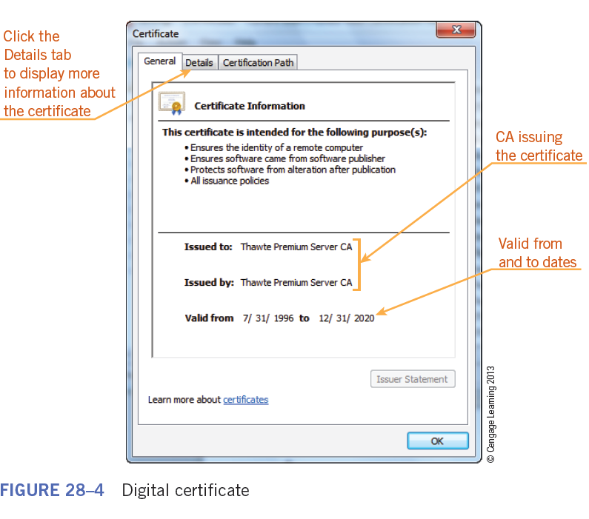
Defining Internet Terminology (continued)
A digital certificate is an electronic document similar to an ID card that verifies the identity of a person or company and confirms that they own a public key.
8
8

Slide 9
Defining Internet Terminology (continued)
A domain identifies a computer or Web site on the Internet.
Encryption is the process of converting text into an unrecognizable format when it is sent. The data is converted to plain text (called decryption) when it reaches its destination.
File Transfer Protocol (FTP) is used to transfer files between computers.
A home page is the first page that appears in the browser when you visit a Web site.
9
9

Slide 10
Defining Internet Terminology (continued)
An Internet service provider (ISP) is a numerical addressing system that uniquely identifies computers and networks linked to the Internet.
An Internet Protocol (IP) address is a numerical addressing system that uniquely identifies computers and networks linked to the Internet.
A podcast is a method of publishing files (primarily audio) to the Internet that can be streamed or downloaded for playback on a computer or personal digital audio player.
10
10

Slide 11
Defining Internet Terminology (continued)
Secure Sockets Layer (SSL) is a protocol for managing the security of message transmissions on the Internet.
A Uniform Resource Locator (URL) is the address of a Web page, FTP site, audio stream, or other Internet resource.
A Web browser is a software program you use to view and retrieve documents from the Web.
Web cache is a temporary storage area on your computer for collecting data.
11
11

Slide 12
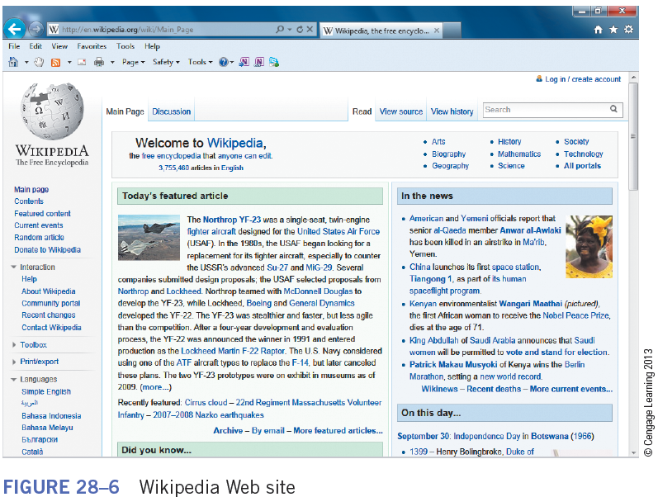
Defining Internet Terminology (continued)
A wiki is a collaborative Web site that people can use to add, edit, remove, and organize Web page content.
Extensible Markup Language (XML) is a flexible text format for creating structured computer documents.
12
12

Slide 13
Defining Internet Terminology (continued)
Understanding Web Page Elements:
A Web page can be a simple text document or it can contain the following elements:
Web site addresses that link to other Web sites
Text, video, or other media
Hyperlinked text and graphics
Interactive objects such as buttons, text boxes, option buttons, check boxes, menus, and lists
Images such as photos, pictures, maps, and drawings
13
13

Slide 14
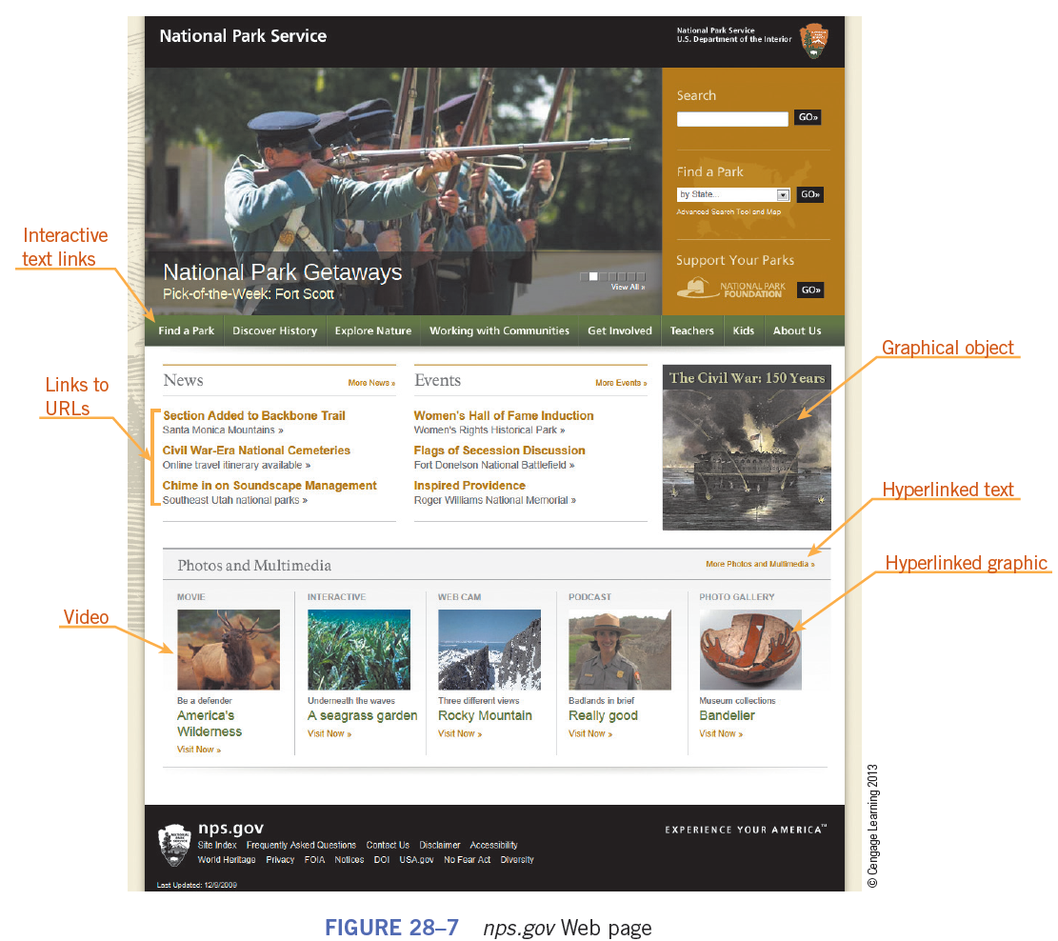
Defining Internet Terminology (continued)
Understanding Web Page Elements (continued):
A Web page that contains most of these elements
14
14

Slide 15
Defining Internet Terminology (continued)
Understanding Web Page Elements (continued):
Web sites can organized into categories, each with a different purpose, such as the following:
Commercial: Known as e-commerce, sites that sell or promote products or services.
Academic: Most educational facilities, elementary to university and pubic to private, have a Web site.
Organizational: Web sites of nonprofit organization and advocacy groups.
15
15

Slide 16
Defining Internet Terminology (continued)
Understanding Web Page Elements (continued):
Governmental: Most local, state, regional, and national governments have Web sites.
International: Web sites hosted in other countries.
Search sites: A search engine is a software program used for online searching.
Secure sites: Web sites used for financial transactions or e-commerce are more secure than sites that simply provide information.
16
16

Slide 17
Defining Internet Terminology (continued)
Understanding Web Page Elements (continued):
Online applications: Known as Web apps, these sites host programs you can access with your Web browser.
Portal: A portal is a Web site that features useful content but also contains links to other sites.
Weblog: A Weblog, or blog, is a Web site designed as an online journal.
Social networking: A social networking site is an online community that provides interaction for groups of people who share a similar interest or activity.
17
17

Slide 18
Defining Internet Terminology (continued)
Understanding Web Page Elements (continued):
Geographic imaging: Mapping and geographic imaging Web sites use technology to change imagery of the Earth’s surface into valuable information.
18
18

Slide 19
Connecting to the Internet
If you connect to the Internet from an office or academic setting, you probably are connecting through a local area network (LAN).
A network interface card (NIC) is a special card inside your computer that allows the computer to be networked.
Home users connect using a high-speed digital telephone line, a cable modem, or a wireless connection.
19
19

Slide 20
Connecting to the Internet (continued)
Connecting to the Internet involves the following steps:
Locate an ISP or an online service.
Install some type of telecommunications software.
You need a Web browser. Most computers come with a browser already installed.
20
20

Slide 21
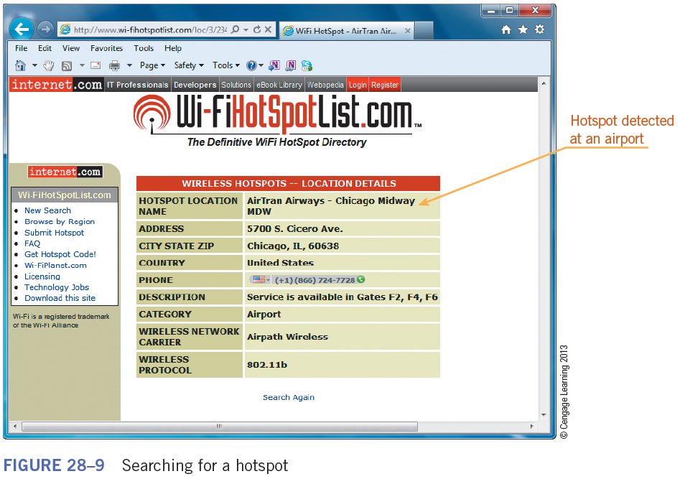
Connecting to the Internet (continued)
You can use hotspots, public wireless hookups, to connect to the Internet when you cannot use your ISP.
21
21

Slide 22
Understanding Browser Basics
A browser is a software program you use to retrieve documents from the Web and to display them in a readable format.
Browsers can display both text and images as well as multi-media information, including sound and video.
You navigate through the Web by clicking hyperlinked words and images.
22
22

Slide 23
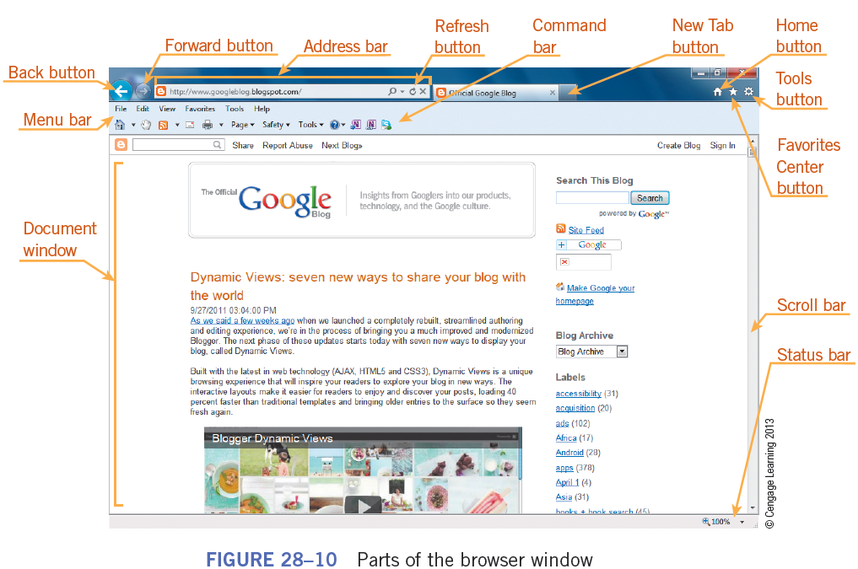
Understanding Browser Basics (continued)
Parts of the Browser Window:
23
23

Slide 24
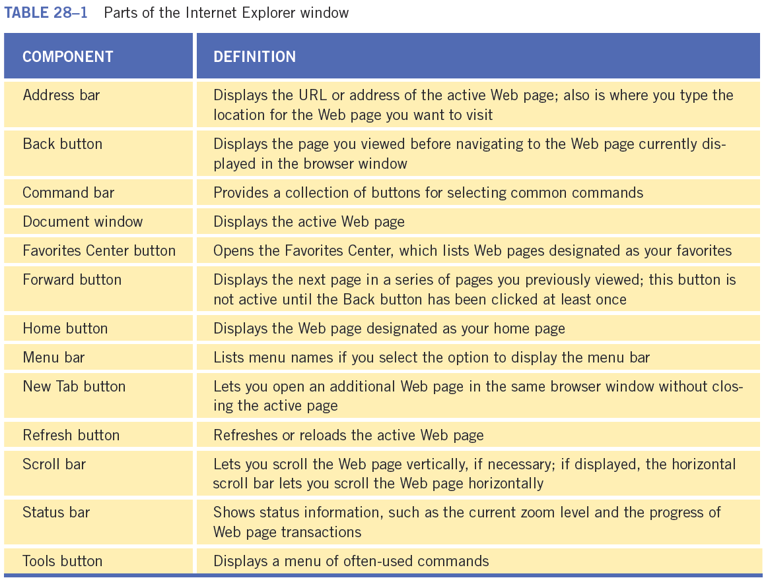
Understanding Browser Basics (continued)
Parts of the Browser Window (continued):
24
24

Slide 25
Understanding Browser Basics (continued)
Navigating the Web:
If you have a direct high-speed connection or a wireless connection, you start your Web browser to display your home page.
Your browser was installed with a default home page.
The Address bar near the top of the browser window contains the URL of the current page. If you want to visit a specific Web site, you enter the address in the Address bar.
25
25

Slide 26
Understanding Browser Basics (continued)
Refreshing or Reloading a Web Page:
Cache memory is high-speed RAM that serves as temporary storage for data you access frequently.
When you visit a Web page, a copy of the contents of the Web page is stored in your cache.
You can refresh a Web page that contains updated information by clicking the Refresh button on the Address bar, selecting View on the menu bar and then clicking Refresh, or by pressing the F5 key.
26
26

Slide 27
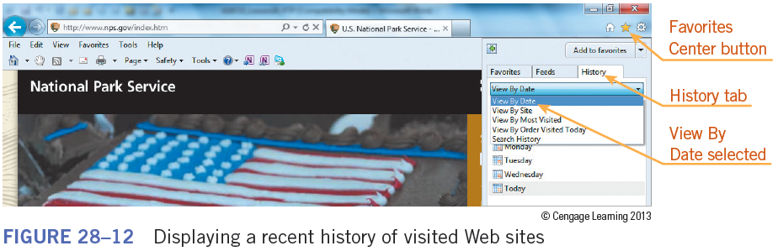
Understanding Browser Basics (continued)
Recent History:
Your browser tracks the sites you have visited for a specific period of time.
You can view a list of recently visited Web sites by clicking the Favorites button and then clicking the History tab.
27
27

Slide 28
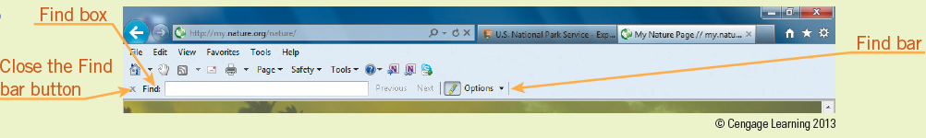
Understanding Browser Basics (continued)
Finding Text on a Web Page:
Large Web sites contain many pages and links, and often provide a search tool specific to the site.
You can also use the Find bar to find text on a Web page.
28
28

Slide 29
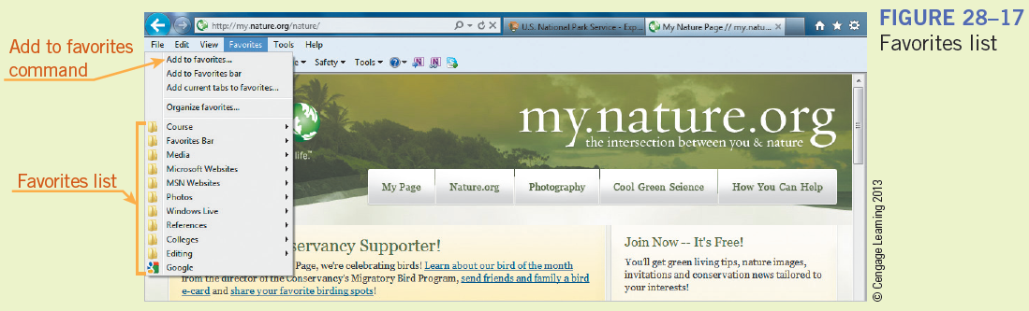
Understanding Browser Basics (continued)
Organizing and Managing Favorites:
The Favorites list contains the addresses of Web sites that you visit frequently, making it easy for you to return to a particular site.
When you add a Web site to your Favorites list, you can access the site by clicking the site name.
29
29

Slide 30
Understanding Browser Basics (continued)
Organizing and Managing Favorites (continued):
After you add a Web site as a favorite or bookmarked site, you can access a site, move a favorite or bookmarked site between folders, and share favorite or bookmarked sites with other users.
30
30

Slide 31
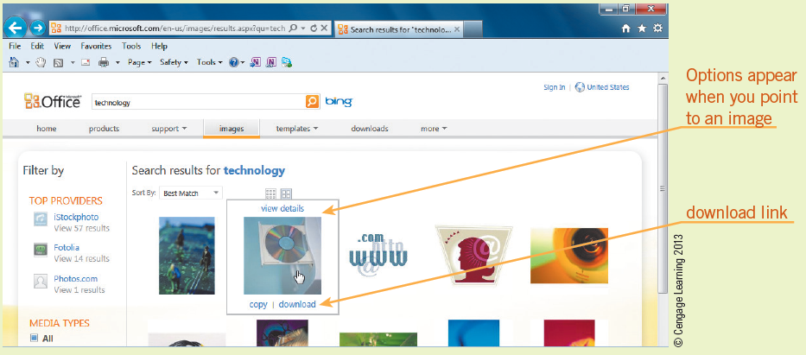
Understanding Browser Basics (continued)
Downloading a File from a Web Site:
You should download files only from reliable sources.
Most sites that have files to download provide an interface that makes the process of downloading simple.
31
31

Slide 32
Understanding Browser Basics (continued)
Copying and Printing Information from a Web Page:
You can copy and save specific elements of a Web page to disk and use them in a new document or file.
You can also print a copy of a Web page directly from your browser.
32
32

Slide 33
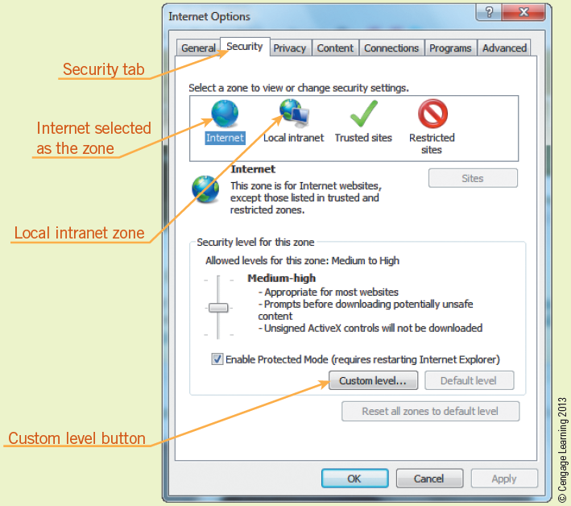
Selecting Web Browser Settings
As you become an experienced Internet user, you may find that you want to change your browser’s security settings.
33
33

Slide 34
Identifying Browser Issues
Page not found or 404 errors might occur because of the following:
The page was moved.
An old index is still maintained in a search engine.
You made a typing error when entering the Web site address
Web pages may load slowly because of heavy server traffic or the page contains a large number of images.
Pop-up ads can be annoying, but can be blocked.
34
34

Slide 35
Summary
In this lesson, you learned:
The Internet and the Web have their own terminology. You should be familiar with terms such as ActiveX, cookies, digital certificate, and domain.
A Web page can be solely a text document or it can be made up of elements such as Web site addresses that link to other Web sites; audio, video, graphics, or other media; hyperlinked text and hyperlinked graphics; and interactive objects such as buttons, text boxes, option buttons, check boxes, menus, and lists.
35
35

Slide 36
Summary (continued)
Select an Internet connection to balance the features you want, such as connection speed and reliability, with the cost and availability of the different options. For example, broadband connections allow multiple channels of information to be transmitted over a single link so more than one channel of video, voice, and computer data can be carried simultaneously.
Parts of the Internet Explorer browser window include the Address bar, document tabs, status bar, and Command bar.
36
36

Slide 37
Summary (continued)
A browser displays a home page when it starts. You use the Address bar to verify the address of the current page and enter addresses to visit other pages. A Web address is called the Uniform Resource Locator (URL), which uniquely identifies each Web page and tells the browser where to locate the page.
37
37

Slide 38
Summary (continued)
Internet Explorer and other browsers provide a favorite or bookmarked sites list to make it easy for you to return to a particular Web site you visit frequently. Internet Explorer provides a Favorites Center that lists and organizes the Web pages in your Favorites list.
38
38

Slide 39
Summary (continued)
Web sites used for financial transactions or e-commerce usually use encrypted communication to make them more secure than sites that simply provide information. Some Web sites also require you to log on using an account or user name and a password.
Problems associated with using the Web include not being able to display Web sites, navigating to pages that are slow to load or contain garbled text, or finding pop-up ads distract you from or block the content on the page.
39
39

